Slide 1

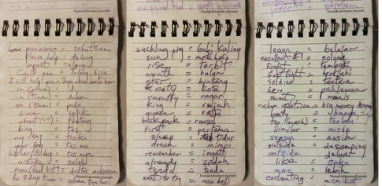
Vocabulary Review
Lizzie Pinard

Slide 2
Session outline
Vocabulary Review
Quiz
What
Why
Bingo
How

Slide 3
Quiz
Why do students forget words?
How does memory work?
How can we help students to remember new vocabulary?
How often do we need to do review activities with students?
When we select review activities, what we do we need to consider?

Slide 4

Bingo!

Slide 5
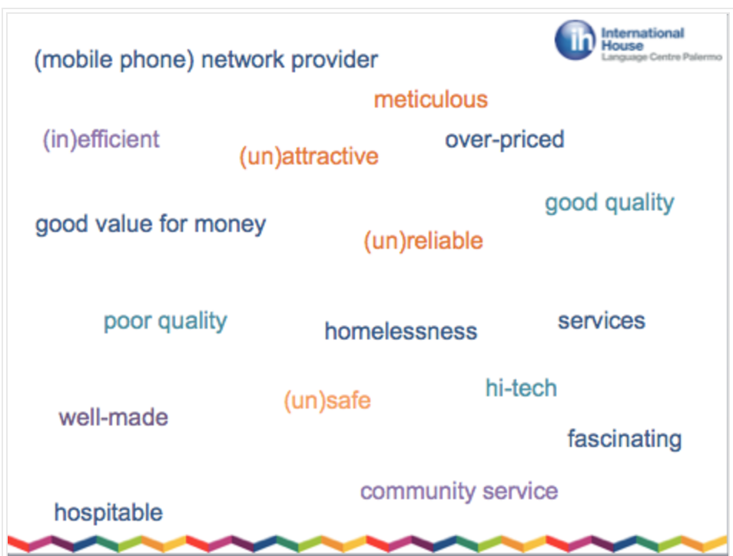
Activity 1
Title: Swat
Materials needed: a slide with all the target words displayed; a flyswat/rolled up magazine /ruler

Slide 6
achievement test
sociolinguistic competence
input hypothesis
interference
collocation
cloze
contrastive analysis
passive vocabulary
descriptive grammar
metalanguage

Slide 7
Activity 2
Title: Just a minute!
Materials needed: sets of cards (one set per group) with one piece of target vocabulary written on each card

Slide 8
Activity 3
Title: Same, opposite or different
Materials needed: Teacher list of target vocabulary in pairs (same, opposite or different!)

Slide 9

Activity 4
Title: Blockbusters
Materials needed: a whiteboard and pens/pre-prepared slide and smart pens

Slide 10

B
I
F
A
S
D
D
P.T.
C.A.
K
P
S
I.T.
F
P.T.
B
B
C
S
A
G
R
A.T.
E
F
S
C
P

Slide 11
Activity 5
Title: Kaboom!
Materials needed: Board, board pens, pre-prepared secret grid

Slide 12
Activity 6
Title: Outburst
Materials needed: Paper and pens (Ss); a list of target categories (T)

Slide 13
Activity 7
Title: Memory challenge
Materials: paper and pens (ss); set of target topics/categories (T) (Also possible via Smartboard/devices)

Slide 14
Activity 8
Title: Q&A
Materials needed: two lists of target words written/projected on board

Slide 15
Word lists
Group A
metalanguage
automaticity
brainstorming
cloze
colloquialism
Group B
discourse competence
comprehensible input
deductive teaching
diagnostic test
interlanguage

Slide 16
Activity 9
Title: Who/What am I?
Materials: post-it notes, with a different target vocabulary item written on each one

Slide 17
References
http://iteslj.org/Techniques/Koprowski-RecylingVocabulary.html
https://www.teachingenglish.org.uk/article/same-opposite-or-different-dictation
http://reflectiveteachingreflectivelearning.com/2015/05/26/vocabulary-review-activity-teens/
http://reflectiveteachingreflectivelearning.com/2015/01/26/60-seconds-a-simple-vocabulary-review-game/
http://reflectiveteachingreflectivelearning.com/2015/02/05/kaboom-the-explosive-team-review-game-with-an-added-twist/

