Slide 1


The Learner Autonomy Maze
By Lizzie Pinard
Notes:
When the Irish created that blessing “may the road rise up to meet you”, I don’t think this left-hand pic is quite what they had in mind…. :-p

Slide 2
Today’s workshop
Theory:
Learner autonomy: What is it? What does it look like?
Practice:
What can we as teachers do to foster it?

Slide 3

What is
Learner Autonomy?
www.ipass-ppc-exam.com

Slide 4

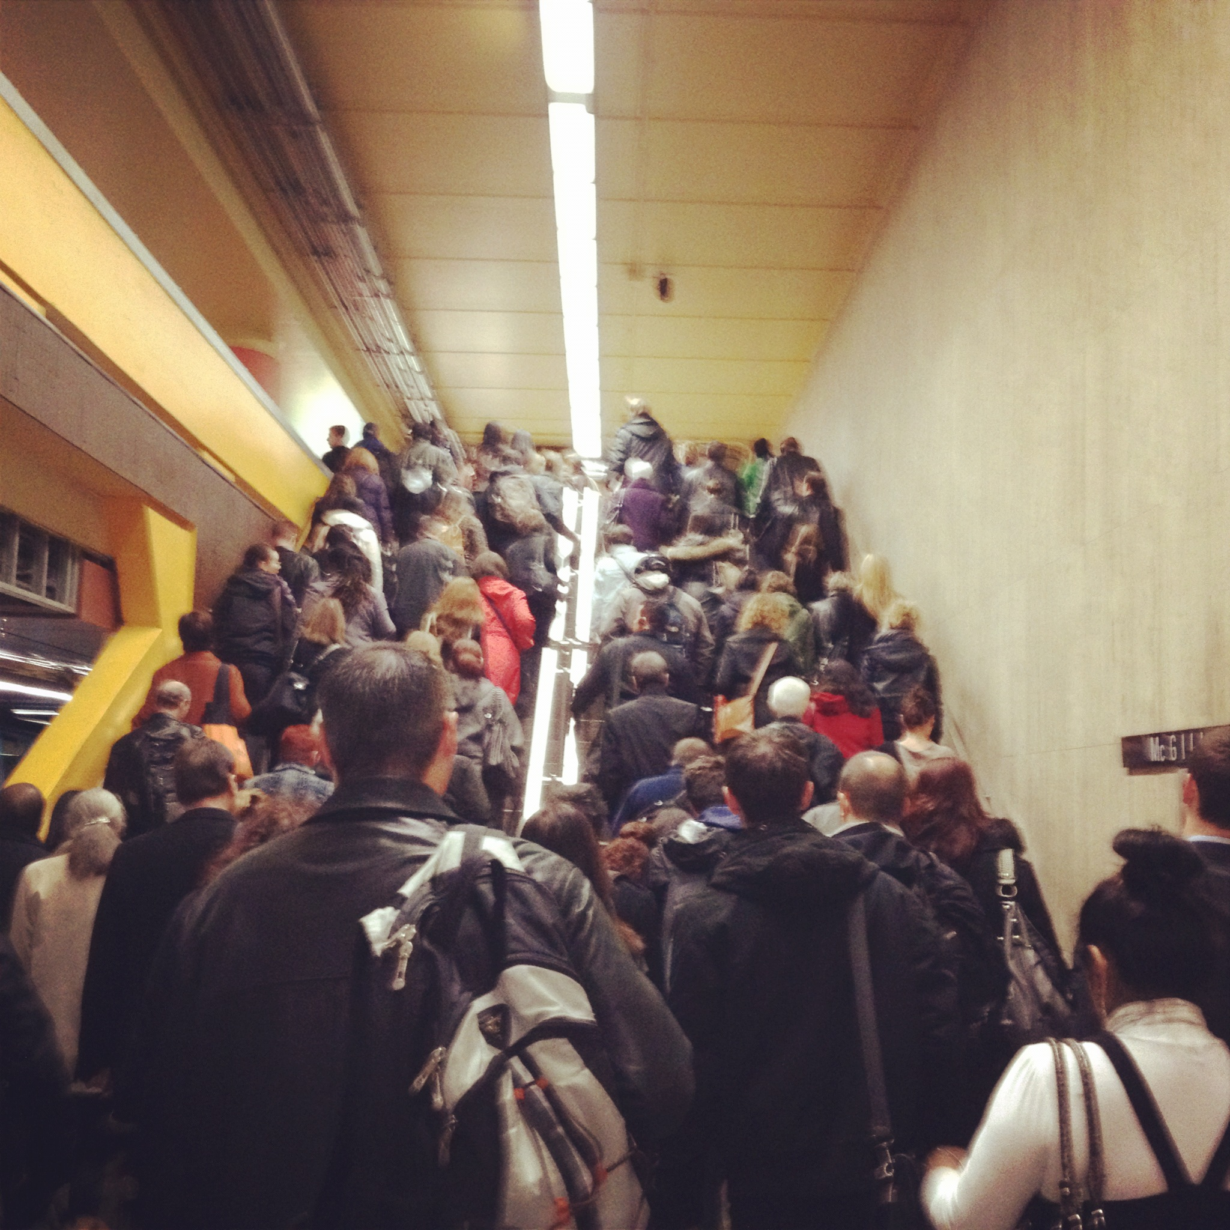

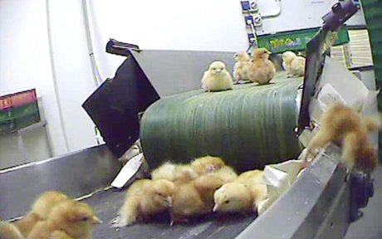
What does it look like?
Ivory tower
?

Slide 5
Definitions
Your answers to these questions may depend on:
which theory your ideas most align with (whether knowingly or unknowingly!)
your context
your own learning experiences/expectations

Slide 6
Please doff your hats…
Holec (1981:3) “learner autonomy is “the ability to take charge of one’s own learning”
And, less frequently, quoted:
“…self-direction in learning must remain a possibility offered to and not forced upon learners.” (ibid:34)

Slide 7


Because, let’s face it…
ignore Holec in a workshop about L.A.!

Slide 8
Different perspectives
Oxford (2003) identifies:
A technical perspective
A psychological perspective
2 x Sociocultural perspectives
A political-critical perspective
Notes:
Firstly, the technical version, in which autonomy consists of the successful acquisition and implementation of a set of skills and techniques enabling learning outside of a classroom context. Secondly, a psychological version, in which autonomy is defined as a capacity consisting of both attitudes and abilities. Thirdly, a political version, in which the emphasis is on control over the learning process and content.

Slide 9
Which perspective is this?
“a ___________ perspective has a central interest in the roles of interaction and social participation in the development of learner autonomy.”
(Borg and Al-Busaidi, 2012:5 )

Slide 10
Which perspective is this?
“a sociocultural perspective has a central interest in the roles of interaction and social participation in the development of learner autonomy.”
(Borg and Al-Busaidi, 2012:5 )

Slide 11

That’s all well, but…
“Where I work, we have to use a course book, the learners can’t choose their content. They wouldn’t want to anyway – they aren’t motivated enough”
“How can the learners take charge? I have to teach the classes, right?”
…where does learner autonomy fit into the average teacher’s classroom life?
www.blog.frannet.com

Slide 12
Resource-Based Approaches
Independent use of learning resources
Benson (2011:125)
Technology-based Approaches
Independent use of learning technologies
Curriculum-Based Approaches
Control over curriculum decisions
Autonomy
Classroom-based Approaches
Control over classroom decisions
Learner-Based Approaches
Development of autonomous learning skills
Teacher-Based Approaches
Focus on teacher roles and teacher education

Slide 13
Motivation
A dynamic system consisting of “two or more elements that are a) interlinked with each other and b) which also change in time.”
(Dornyei and Ushioda, 2012: kindle loc 1910)
“Developing your students’ motivation to learn involves socializing it as a general disposition as well as stimulating it situationally in the process of implementing lessons and learning activities.”
(ibid: kindle loc. 2188)
Notes:
not static, in constant flux

Slide 14
“Motivational Flow”
occurs when:
“1) there is a perceived balance of task challenge and participant skills during the task
2) the task offers opportunities for intense concentration and the participants’ attention is focused on the pursuit of clear task goals
3) the participants find the task intrinsically interesting or authentic, and
4) the participants perceive a sense of control over the task process and outcomes.”
(Egbert 2003 in Dornyei and Ushioda 2012: 97)

Slide 15
Metacognition
“a state of consciousness of our own thoughts as we focus on a particular cognitive or learning situation.” (Vandergrift and Goh, 2012: loc 2027-2044)
person knowledge, task knowledge, strategy knowledge (Vandergrift and Goh, 2012)
‘construction manager’; ‘orchestra conductor’ (Oxford, 2011)

Slide 16

Methodological Possibilities
Strong v weak (Smith, 2003)
The “good language learner” …?
The role of the teacher?
Learner autonomy is for outside the classroom, not inside it. …or is it?
(www.clipartangel.com)
Notes:
Strong – start from learners, develop your approach WITH them.
Weak – transmit a set of behaviours which you associate with the good language learner
GLL – who IS that??? And what about all the human language learners?
LA often used in association with bridges from the classroom to the world outside: a seamless process of walking over a bridge and tadaah! In reality, not that simple?

Slide 17

Reminder:
What is successful and what isn’t depends on YOUR context and YOUR learners: start with what THEY bring to the table.
Ideas to adapt as YOU see fit – NOT NOT ‘instant packages’ of learner autonomy.
(iblog.dearbornschools.org)
Notes:
Pre-packaged learner autonomy doesn’t exist

Slide 18

Reading
Do your students read in English in their spare time outside class?
Do they do it because you told them to or because they chose to?
Do they read what they choose to read or what you tell them to read?
What happens when you stop telling them when and what to read?

Slide 19

Principles of the “Reading Project”:
Open a dialogue with the learners
Start from what THEY bring to the table: what do *they* know about:
The Benefits of reading
Choice of reading materials
Approaches
Choice; goals; regular discussion
www.theprospect.net

Slide 20
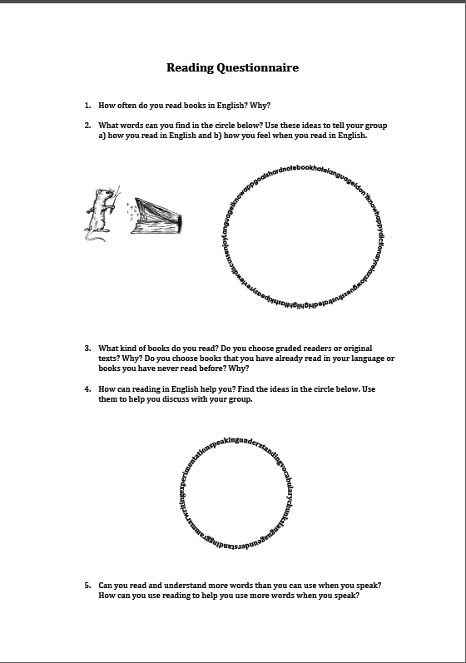

Slide 21

“Experimenting with English” project
Do your students use English outside class?
Is this homework or using it through choice?
Do your students do a range of different activities or just one e.g. watching films?
Are your students’ choices informed or default choices?
www.govlopp.org

Slide 22
Potential Issues
lack of motivation
lack of tools/ideas
lack of success
lack of confidence
lack of time

Slide 23
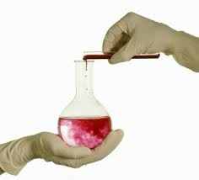

‘Experimenting with English’ project: principles
Scaffolded experimentation with different activities; non-compulsory, student choice
Regular discussions; goal setting
Collaboration; idea sharing, trouble-shooting
Motivation (harnessing and management)
awritersworld.blogspot.com
www.langevin.com

Slide 24
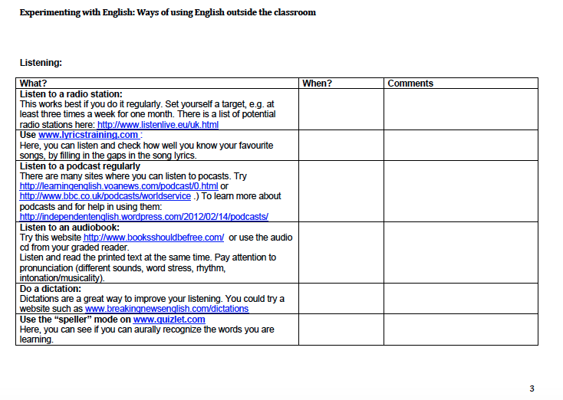

Slide 25
Goals
“clear and specific”
“challenging and difficult,
yet realistic”
“stated completion date”
Dornyei and Ushioda’s (2012: 120)
Six Main Principles
“measurable;
can be clearly evaluated”
“proximal and distal”
T to “provide feedback that increases students’
self-efficacy for obtaining the goal”

Slide 26
“Motivational Flow”
occurs when:
“1) there is a perceived balance of task challenge and participant skills during the task
2) the task offers opportunities for intense concentration and the participants’ attention is focused on the pursuit of clear task goals
3) the participants find the task intrinsically interesting or authentic, and
4) the participants perceive a sense of control over the task process and outcomes.”
(Egbert 2003 in Dornyei and Ushioda 2012: 97)

Slide 27
EAP
(Summer School)
listening logs
strategy tables
resource experimentation
regular reflection and evaluation
www.wordandphrase.info

Slide 28
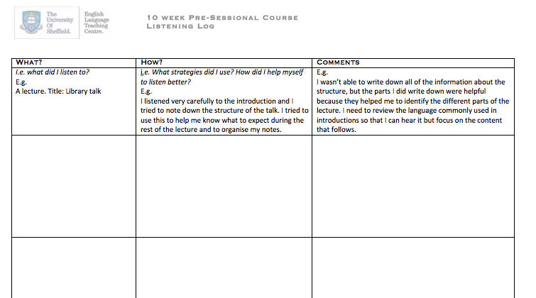
Listening Log
Vandergrift and Goh (2012)

Slide 29
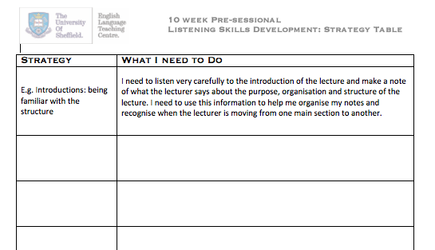
Strategy Table
Vandergrift and Goh (2012)

Slide 30
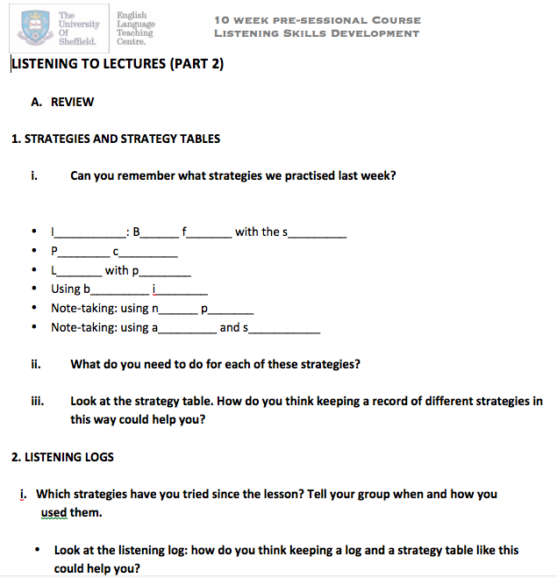
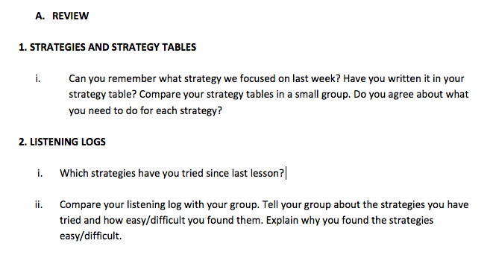
Resource Experimentation/Evaluation (1)

Slide 31
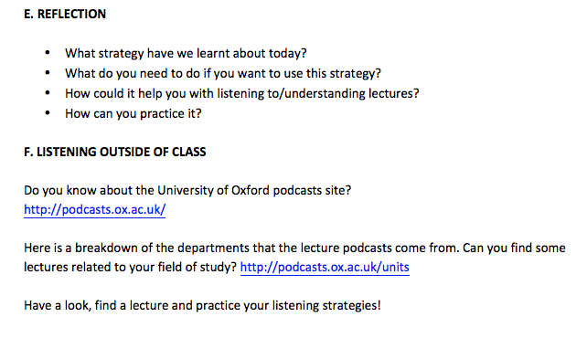
Resource Experimentation/Evaluation (2)

Slide 32
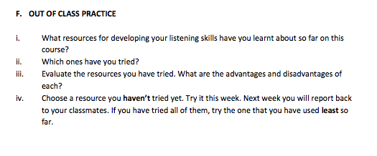
Resource Experimentation/Evaluation (3)

Slide 33
Common themes?
Non-compulsory [“The teacher made the tools not compulsory, which was already the best way to use them”]
Discussion; metacognition; process (not limited to these projects)
Scaffolding from inside the classroom; support: fostering autonomy vs. expecting it.
Motivation; choice
Start from what the learners bring to the table

Slide 34

Things to keep in mind…
The importance of choice:
“…self-direction in learning must remain a possibility offered to and not forced upon learners.”
(Holec, 1981)
www.tarotdiva.com

Slide 35


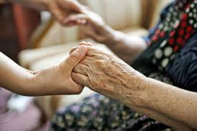
Remember the person as well as the learner:
“the term ‘learner’ refers to only certain attributes of the person of the student as they are constructed in the classroom by teacher-designed events.”
(Holliday, 2005 kindle loc 1570)
livinginqatarinfor.com
cvesd.org
rcs-domhomecare.org

Slide 36

Bring autonomy INTO the classroom:
We need to create “a supportive and encouraging learning environment which can help to lower anxiety filters and challenge students to consider new or alternative methods of learning.”
(McCarthy, 2013 kindle loc 4662)
www.ctdudel.edu

Slide 37

The role of the teacher:
“…fostering autonomy does not mean simply leaving learners to their own devices, but implies a more active process of guidance and encouragement to help learners extend and systematise the capacities they already possess.”
(Benson, 2011:91)
www.123rf.org

Slide 38

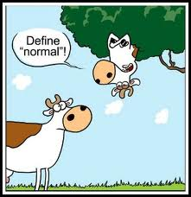
The autonomy mindset:
“own awareness of […] role and practices is critically important to any pedagogy for autonomy.”
(Smith and Ushioda,2009:kindle loc 4558)
www.bratfordschools.net
www.gorkana.com
Notes:
gorkana.com

Slide 39
Conclusion
“we cannot teach students to become more autonomous [but] we can create the atmosphere and conditions in which they will feel encouraged to develop the autonomy they already have”
(Benson, 2003:305)

Slide 40
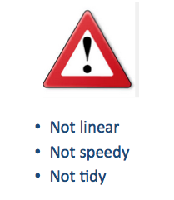

Slide 41
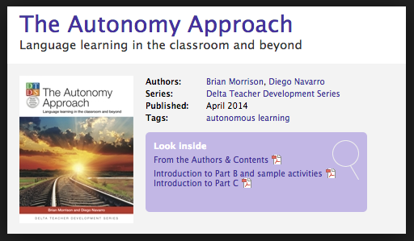

Recommended Reading
http://reflectiveteachingreflectivelearning.com/2014/05/21/my-top-ten-learner-autonomy-and-metacognition-resources/

Slide 42
References
A summary and list of references will be available on my blog!

