Slide 1


Is anybody reading this?
Making writing interactive.
Lizzie Pinard
image taken from en.wikipeadia.org
screenshot www.edmodo.com

Slide 2
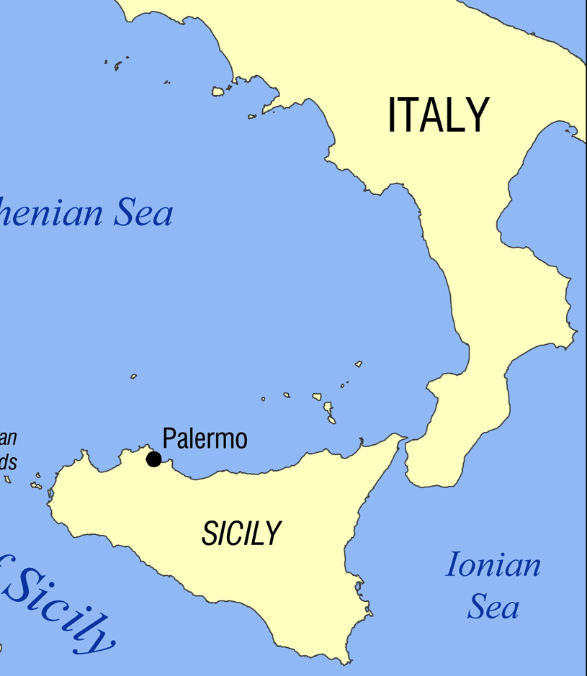

Me
www.en.wikipedia.org
Teacher (of General English, at International House in Palermo; of EAP at University of Sheffield)
Learner (of language, of teaching)
Buongiorno!
Notes:
I’m wearing three hats for this talk (quite a feat given I only have one head! :-p)

Slide 3
Presentation Outline
What is writing? Why do we do it?
Issues with writing
The 4 ‘C’s
Activity ideas
Student feedback
Q&A/discussion

Slide 4
Writing
fluency?
purpose?
Structure?
structure?
organisation of ideas?
Accuracy?
handwriting?
spelling?
punctuation?
grammar/lexis?
coherence?
genre?
autonomy?
homework?

Slide 5
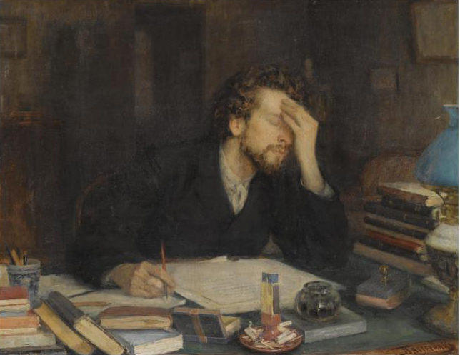
Issues
Balancing act
Vagueness of purpose
Motivation
Engagement
Homework
Your ideas?
image taken from en.wikipeadia org

Slide 6
The 4 ‘C’s
What can Edmodo/Blogs (etc.) bring to the party?
C-ommunication
C-ollaboration
C-reativity
C-omparison

Slide 7
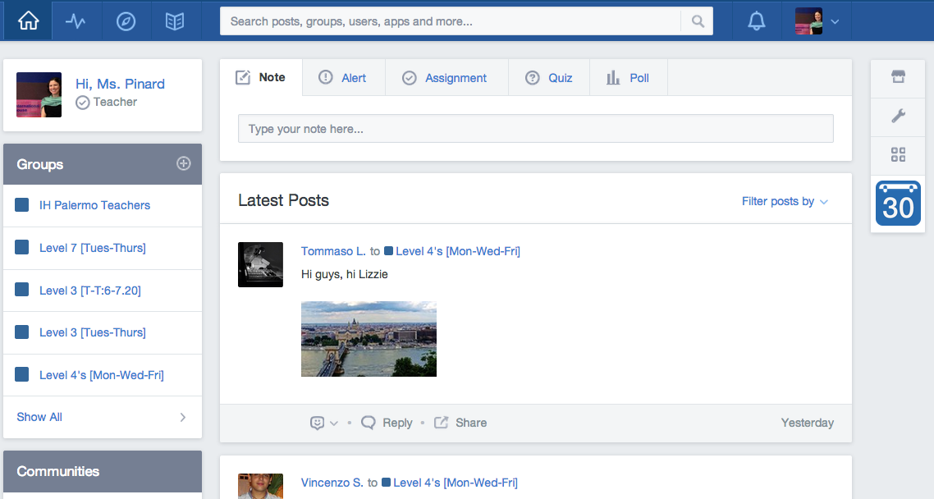
What is Edmodo?

Slide 8
How do I use Edmodo?
http://reflectiveteachingreflectivelearning.com/2014/03/28/edmodo-workshop-2832014-a-how-to-for-teachers/
(Technical) guidance for using Edmodo.

Slide 9
C-ommunication
Real-world writing:
writing to communicate something to somebody.
Examples?
gratitude, complaint, enquiry, “catching up”, persuasion, dissemination of information, sharing stories…

Slide 10
C-ommunication
Classroom writing:
writing for the teacher to correct errors; to “practice” using a language point or writing within a particular genre.

Slide 11
C-ommunication
Edmodo/blogs-based writing:
Genuine communication
Fluency
Process
Audience

Slide 12
C-ollaboration
In the classroom:
pair- and group-work;
process writing.
At home:
now do it alone.

Slide 13
C-ollaboration
Edmodo/blogs-based writing:
writing as process
sharing ideas
minimizing isolation
pair-, group- and whole-class work at home

Slide 14
C-reativity
In the classroom:
Teacher does his/her best to inspire students to create; adapts the course book, uses different interaction patterns.
At home:
Student v. blank page: the battle begins

Slide 15
C-reativity
Edmodo/blogs-based writing:
Writing as a form of creativity
Getting the creative juices flowing
Interactive use of resources

Slide 16
C-omparison
In the classroom:
peer-editing
“spying” on other groups/pairs
At home:
Me, my homework and I.

Slide 17
C-omparison
Edmodo/blogs-based writing:
What is everybody else up to?
What can I learn from what they do well?
What can I learn from their mistakes?

Slide 18
The 4 ‘C’s
Edmodo/Blogs:
C-ommunication
C-ollaboration
C-reativity
C-omparison

Slide 19
Activity Ideas
Diagnostic
Question Time
Past, present, future
Homework:
Spot the difference – the news/summaries
Any comments? – evaluation
Time for a chat

Slide 20
Activity Ideas
Games
Picture stories
Definitions and descriptions
Picture dictations
Project work
Learning to learn

Slide 21
From Homework to Autonomy
Experimenting with English
Graded Reader activities
Learning contracts

Slide 22
Student Feedback
“Edmodo is a good way for know the classmate.in the same time is a good idea to improve our knowledge and confront opinion and so on! besides is a good tool to read and think in the english mode.”
“Edmodo is a good idea because we can write, read and talk in english with our classmate. We can improve our english with text, podcast that one user post and we can link an immage and describe it and we can talk about it togethere.”

Slide 23
Student Feedback
“Edmodo is a funny way to keep in touch! You can also discuss (in English) about everything you want and share links, photo, files...”
“Edmodo simply is an informatics tool for the class students more usefull than a personal mail because It gives the possibilities to close the comunications only between them!”
“Edmodo is like a forum. Of course if you write about everythingh in English, you'll improve your writing. It's funnier than doing homework on your notebook. You can write wherever you are (at the moment I'm writing while people are talking about neuroprotection!)”

Slide 24
Student Feedback
Edmodo is a usuful way to continue your english studies outside the school. Thanks to this group you can compare your homeworks,share your favourite links and discuss about everything you want to discuss! At first,I thought the typical workbook was better than this innovative way ,instead the prons are lots. Everywhere you are,you can look up something you learnt but that you forgot asking something writing on ed-modo, 'cause thanks to the app available for smartphones,you can connect in a real time and you'll find the other one who will answer to your posts. Even your teacher will be on ed-modo who will correct your homeworks and will answer to your doubts accelerating your studies without waiting for the next lessons beginning.

Slide 25
For more information:
Have a look:
www.reflectiveteachingreflectivelearning.com
Get in touch:
@lizzie.pinard
lizzie.pinard@gmail.com

Slide 26


Thank you for listening!
Any questions?
image from www.openclipart.org
image from www.openclipart.org

