Slide 1

What about the other 165 hours a week?
Scaffolding out-of-class language acquisition
Lizzie Pinard
image from en.wikipedia.org

Slide 2
Presentation outline
Obstacles to language acquisition
My projects for overcoming obstacles
Discussion and ideas exchange

Slide 3

Obstacles
Time
Motivation
Coursebook
parcels
Teacher
Autonomy
Resource awareness
image from www.en.wikipedia.org
Learner Autonomy
Notes:
Time - ;learners often think that if they don’t have 3hrs to dedicate then it’s not worth starting. Whereas as little as 10 or 20 minutes is of value, if regular. The regularity is the key.
Motivation – learners may not perceive the utility of out of class use of language and therefore may not bother, esp if progress is (as often is) not speedy enough/not readily perceptible.
Resource management (requires L.A./scaffolding; varied exposure to and use of language, incidental exposure and focused exposure, incidental use, focused use. Engaging with language in different ways. – so not just watching a film now and then.
Learner autonomy (lack thereof)/dependence on teacher
Teacher autonomy if teachers lack autonomy in the classroom, stick to course books, don’t bring other things in (and back into) the classroom, then learners won’t develop autonomy either

Slide 4
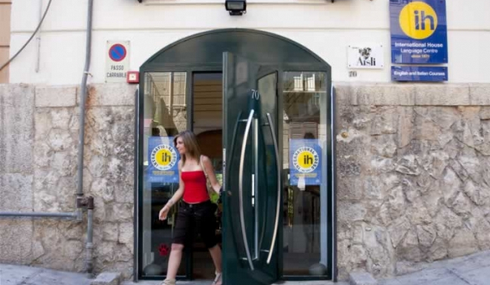
My Context
International House, Palermo
image from IH World website

Slide 5
My Goals
Increase learners’ exposure to English.
Motivate learners to use English/the rich resources of English outside the classroom.
Help learners take control over their learning.
Expand learners’ horizons beyond the little packages of language in the coursebook.
Stimulate curiosity: to help learners find activities they like doing and will do regularly.

Slide 6
My Projects
The Reading Project
Experimenting with English
Helping learners come language researchers
Using collaborative tools
(Compass)

Slide 7
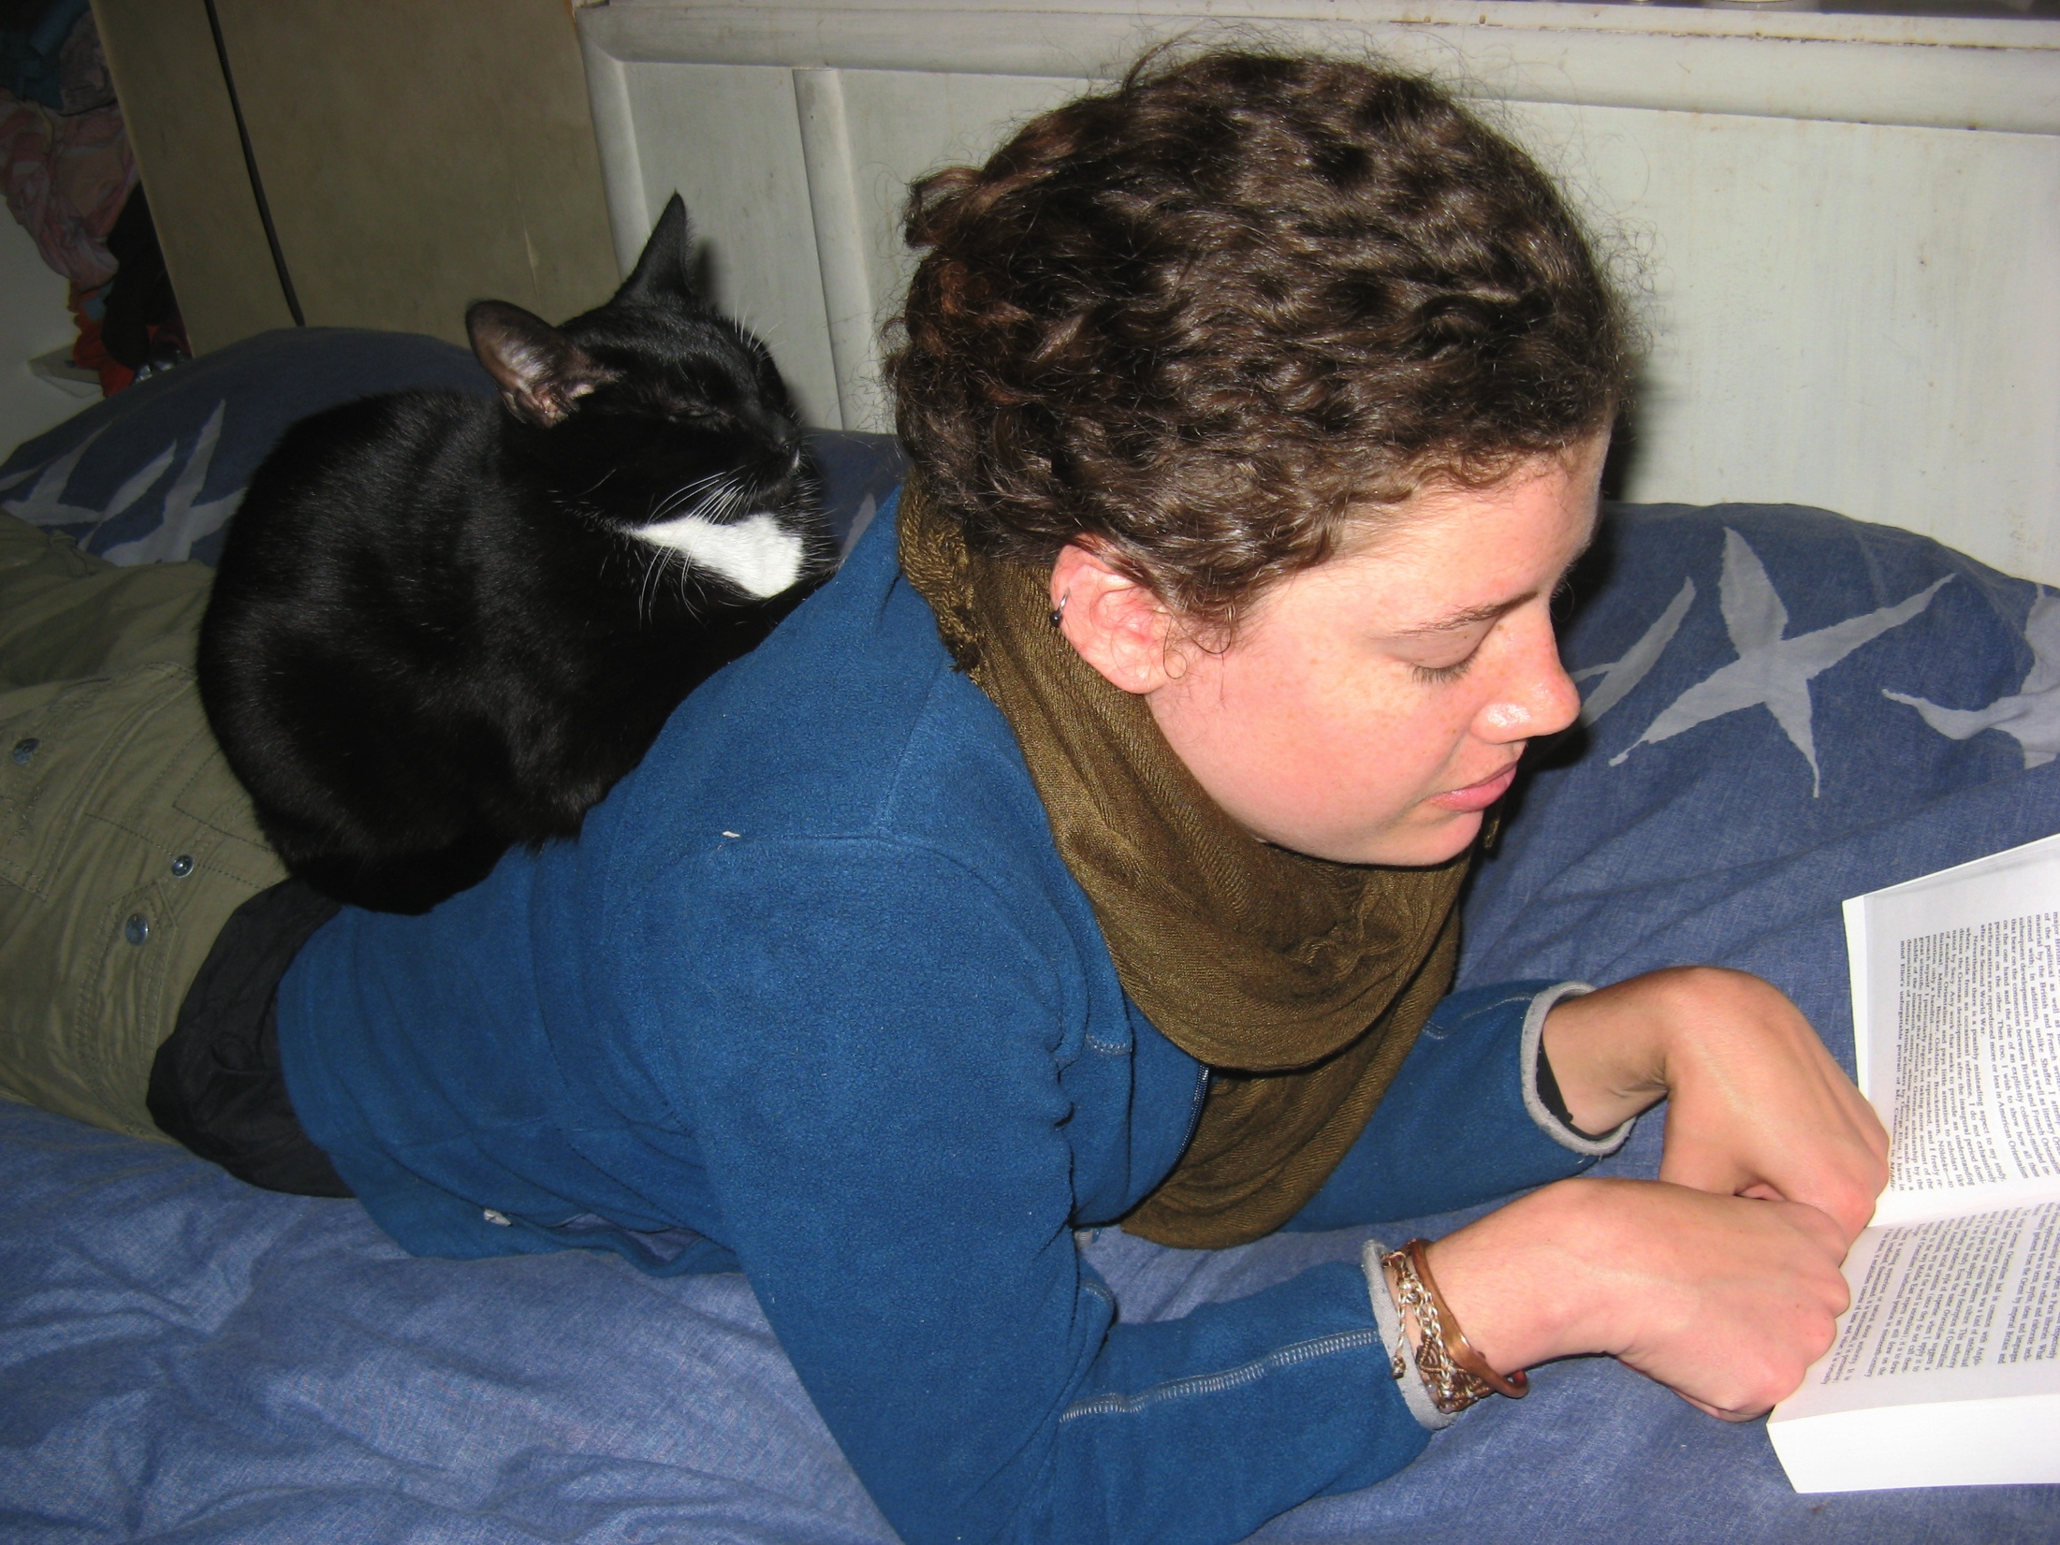
The Reading Project
my own image

Slide 8

The Reading Project

Slide 9
The Reading Project
Purpose/benefits clear to students
Discussion (regular)
Motivation (goals; the more you read, the more you want to)
Varied goals
Metacognition

Slide 10

Student feedback
commons.wikimedia.org
Will you continue to read in English after the course?
“I like reading in English. I found a new word: English Lettereture. I choose amazing English book and I thanks you for this reason.”
“I want to continue to read in English because I think it’s a good tool to learn new words”
“Yes, because I understood that it is useful, and because now I like reading a book in English”
“I think that it is important and I like read in English”

Slide 11
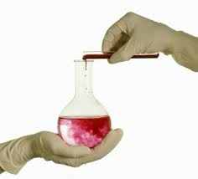
Experimenting with English
image taken from awritersworld.blogspot.com

Slide 12
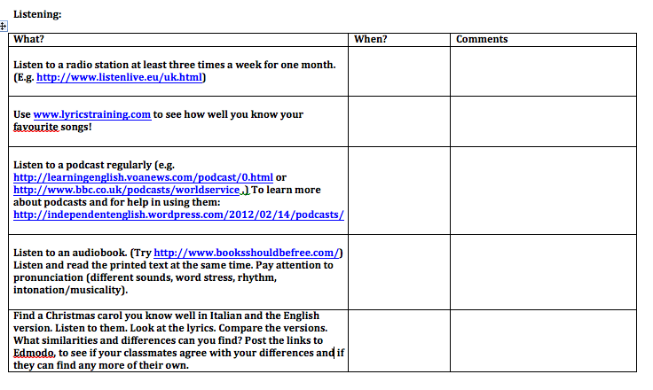
Experimenting with English
Sample page from activities handout

Slide 13
Experimenting with English
ideas
goals
metacognitive reflection/discussion
choice/control
motivational flow

Slide 14
Motivational Flow
balance of challenge and skills
opportunities for focus, clear goals
intrinsic interest/authenticity of task
sense of control over task process
(Dornyei and Ushioda, 2012)

Slide 15
Student Feedback
…thanks to the extra activities I improved my comprehension of english. It was useful also because I could speak a lot in english during the lessons.
“The discussions is a good thing for me”
I believe that this course has offered many tools of learning, overall because It aims at improvement of own capacity of listening and communicative competence.
It has been a short but intense route of Learning giving me new enthusiasm and competence in the process of Learning

Slide 16
Learners to Language Researchers
wordandphrase.info
noticing patterns in language
exploring language

Slide 17
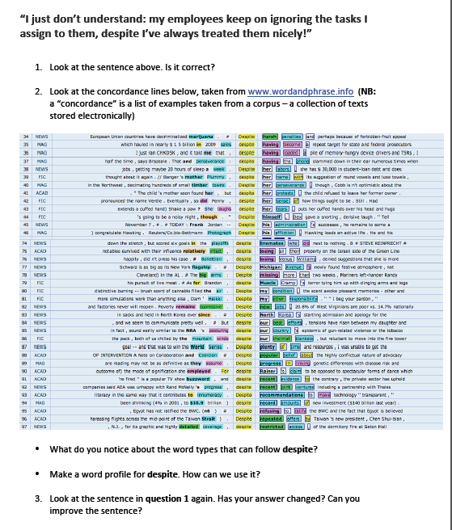
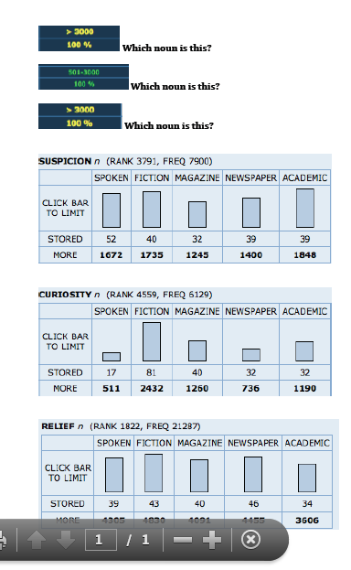
Learners to Language Researchers
sample materials
used with learners

Slide 18
Using “collaborative tools”
Fancy way for saying blogs/Edmodo/wikis – computer-mediated communication tools that give learners a platform to connect.

Slide 19
Student Feedback
“I found wordandphrase.info extremely useful as a method of learning and the blog prompted me to write more than before.
“I’ve especially appreciated wordandphrase, and I’ve found interesting the reading project.”
“I liked the class blog and the websites very much, because I think they can really improve our writing and reading skills, plus searching and “linking words” (collocations) activities.

Slide 20

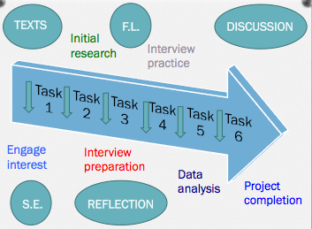
Compass

Slide 21
Outcomes
Lots of positive feedback from students
A long way to go!

Slide 22
Thank you for listening!

Slide 23
References
www.reflectiveteachingreflectivelearning.com/matsda2014
links to information about my projects
links to all the references made in this presentation and many more that may be of interest
links to copies of the materials I’ve made in the course of carrying out these projects

Slide 24
Discussion
Any questions about any of my projects?
How would you adapt my ideas to your context? How would you add to my ideas?
What kind of materials do you think would enhance these projects? For teachers? For learners?

