Slide 1

From teacher to enabler: stimulating acquisition
Lizzie Pinard, IH Palermo
Notes:
Please change the IH World Organisation logo to your school’s logo where possible.

Slide 2



Why?

Slide 3
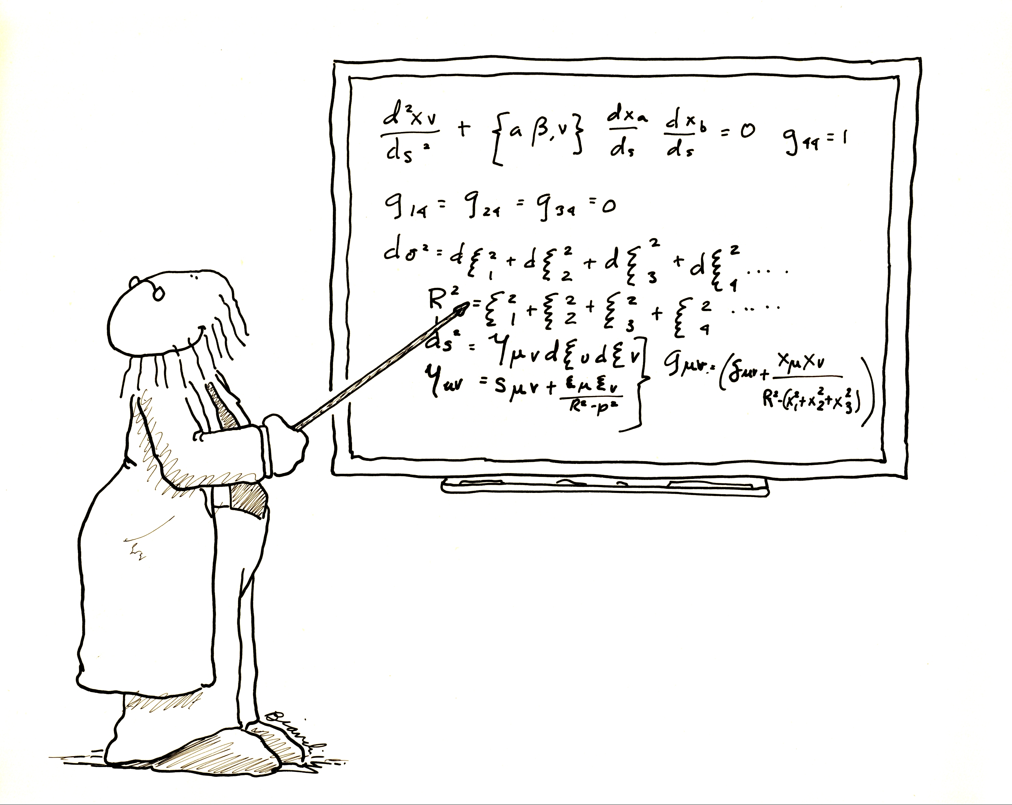

How much time do your learners spend in the classroom?
Time/location equation
image taken from
www.masspoliticsprof.org
image taken from
www.pixabay.org

Slide 4
3 steps to enabling out-of-class acquisition in addition to in-class learning
autonomy
meaningful use of language
metacognition
communication
exposure to language

Slide 5
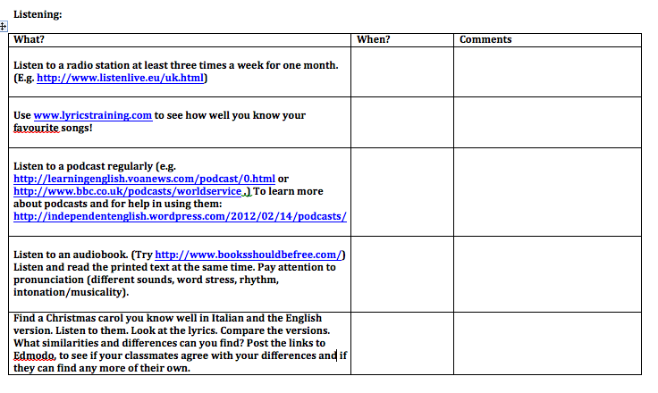
1. Encourage experimentation

Slide 6
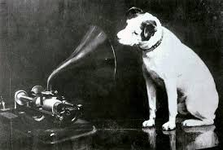


Get learners goal-setting
image taken from
jaymerzy.deviantart.com
images taken from
www.en.wikipedia.org
Goal-setting theory:
Locke and Latham (1990)

Slide 7

3. Keep Talking!
Motivational flow (Egbert, 2003):
balance of challenge and skills
opportunities for focus, clear goals
intrinsic interest/authenticity of task
sense of control over task process
image taken from
www,pixabay.org
Bring it back into the classroom…

Slide 8

Both enthusiasm and boredom are infectious!
image taken from
www.pixabay.org

Slide 9
Thank you for listening! http://reflectiveteachingreflectivelearning.com/learner-autonomy/

