Slide 1

Using Edmodo!
Lizzie Pinard
International House Language Centre Palermo
With thanks to: Everybody! ☺

Slide 2

Workshop Outline
What is Edmodo?
Edmodo as a teacher (“How do I…?”)
Edmodo as a learner (“How do they…?”)
Integrating Edmodo (Homework; autonomous use)
Potential issues (“But what about…?)

Slide 3
Edmodo is…
“a free and safe way for students and teachers to connect and collaborate”

Slide 4
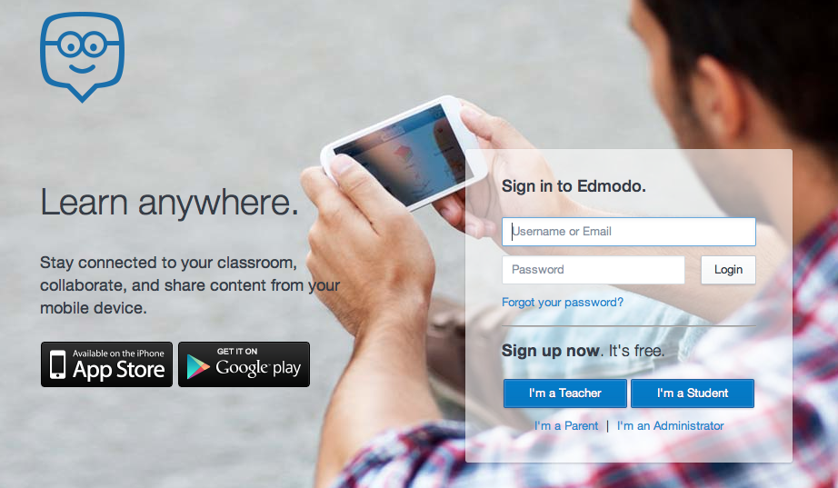
Edmodo (as a teacher)

Slide 5
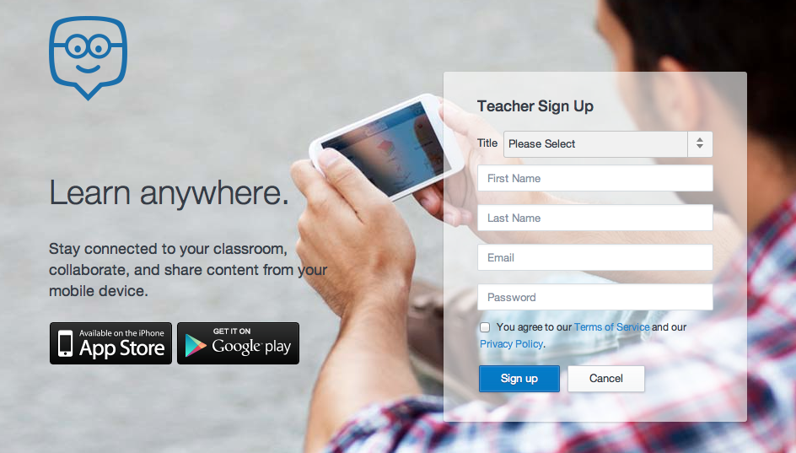
First, sign up…

Slide 6
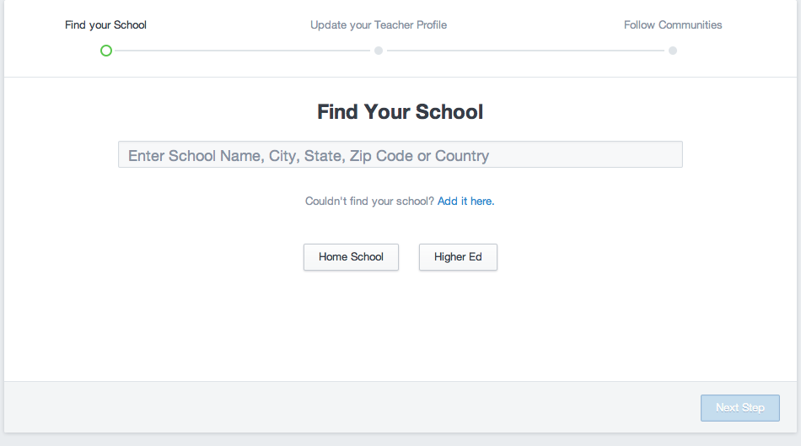
Now, find your school...

Slide 7
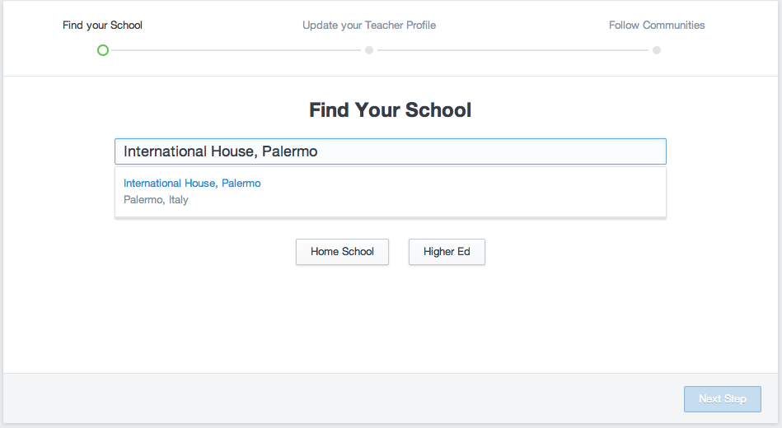
Type in your school’s name:
Notes:
If your school isn’t already registered, you can add it…

Slide 8
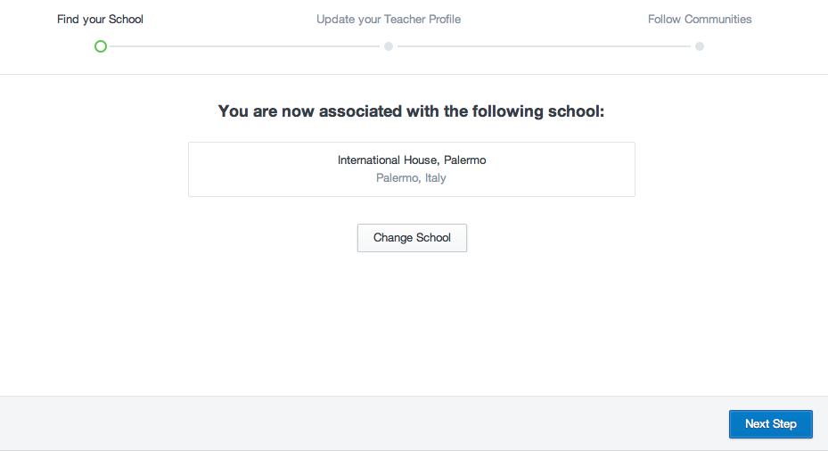
So far, so good!
Notes:
You are now associated with your school!

Slide 9
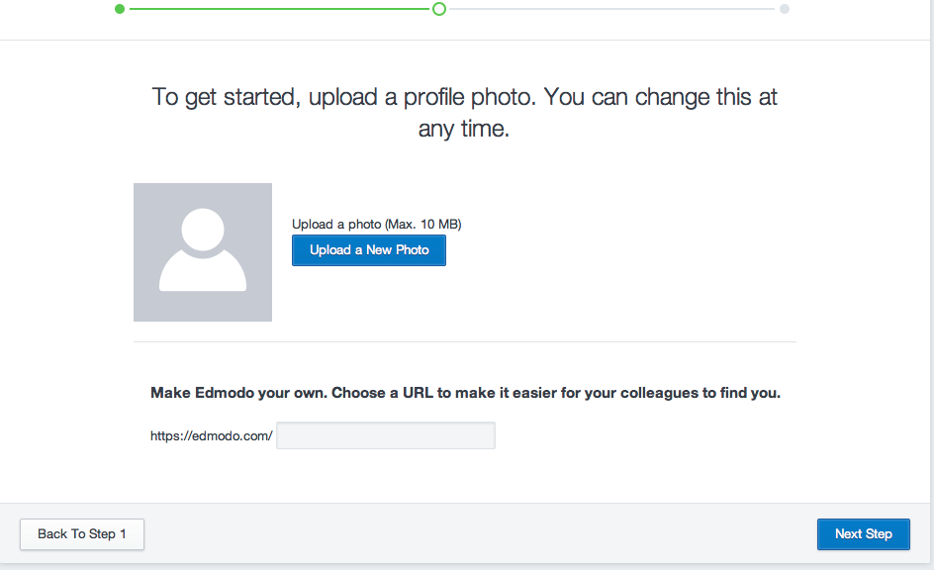
Upload your picture (if you want!)
Notes:
You don’t have to, but it’s probably nice for your students and may encourage *them* to upload their own pics, which may be more conducive to a nice community feel.

Slide 10
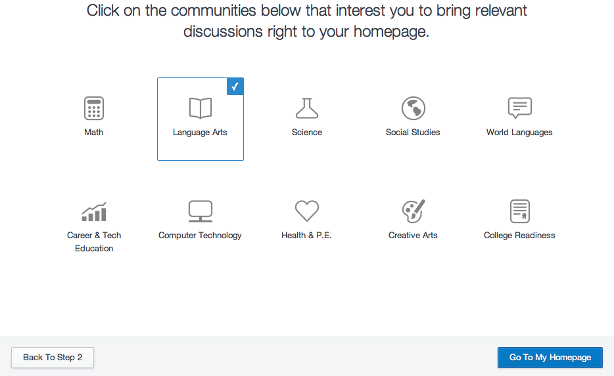
Again, optional…
Notes:
You get lots of messages from randoms cluttering up your page if you select communities here. This may or may not appeal to you!

Slide 11
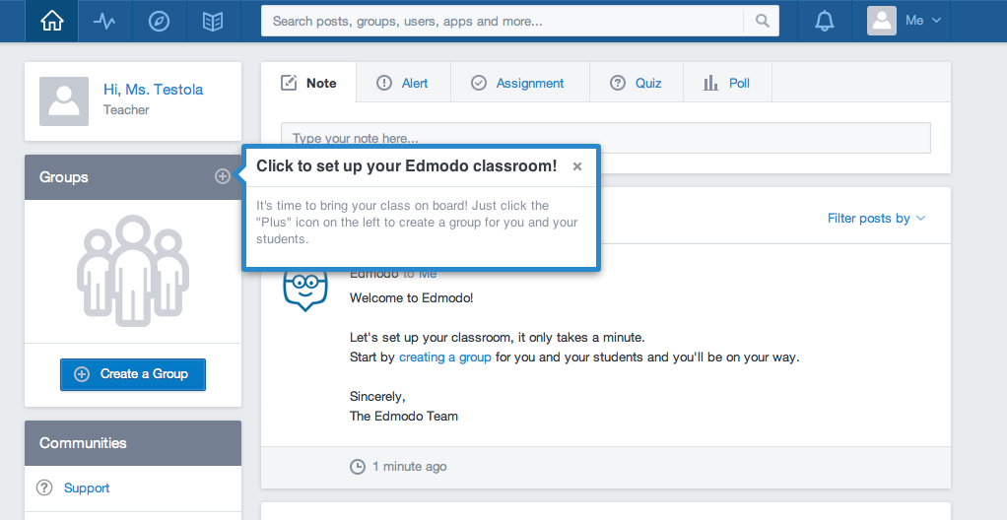
Now to get down to business!
Notes:
For each class you want to use Edmodo with, you need to set up a group…

Slide 12
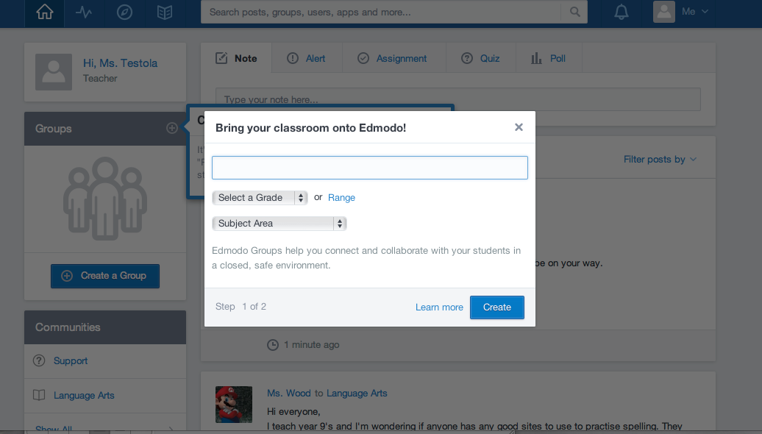
Give your group page a name:
Notes:
Remember, this name is for you and your students. I tend to name the groups by Level and Class Days (and Time if you teach more than one of the same level on the same day e.g. me with my Level 3’s!)

Slide 13
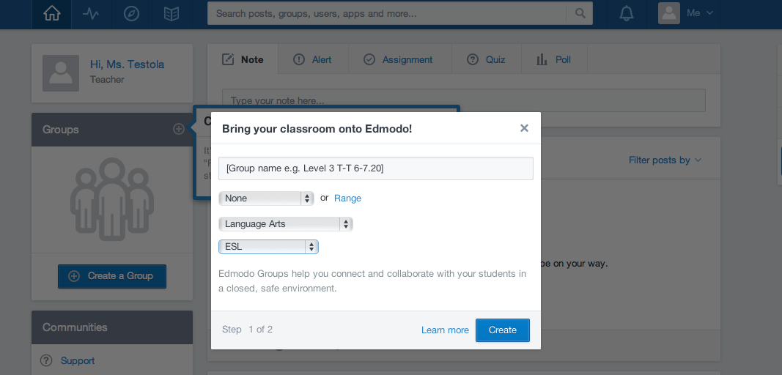
Define your group:
Notes:
For adult EFL/ESL classes, select “language arts” and then “ESL”
If you are using it with young learners (probably not here), then you can select the grade range too.

Slide 14
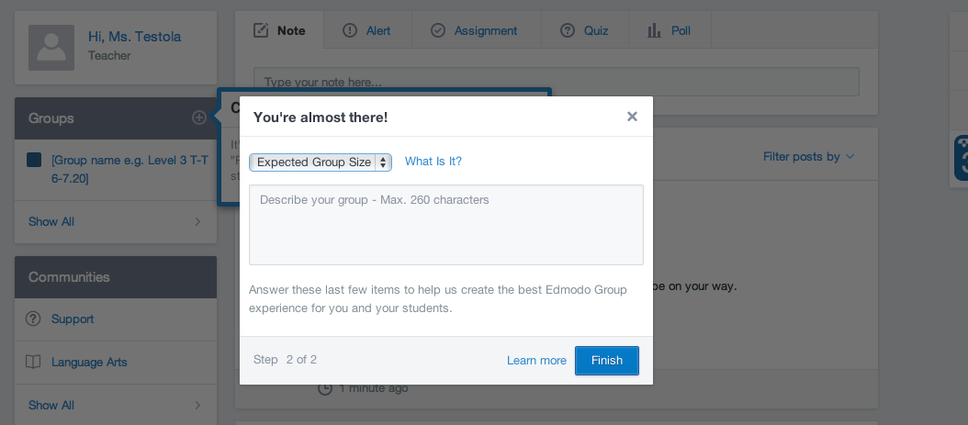
How big will your group be?
Notes:
Choose the class size. Write about it if you want, I don’t usually.

Slide 15
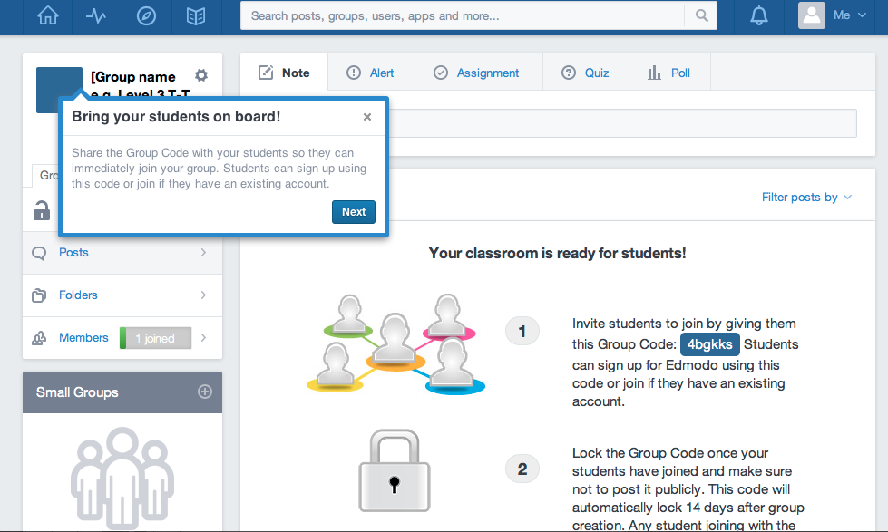
Ta-dah! Your new classroom!
Notes:
Once you have set up your group, you arrive in your classroom.
The “Your classroom is ready for students” helps you to get your students into your group but will disappear when you post something.
All you really need to be able to do beyond this setting up stage is:
type something in the box where it says “note”
select who to send it to (if you are on your home page, you will need to choose which class, if you are on the class page, it automatically selects that class)
The alert/assignment/quiz/poll are all optional. I don’t use them that much but the poll (which I have used once or twice) can be a bit of fun, can also help you get a feel for class opinion on something easily.
Use the buttons that appear underneath the note box when you click on it, to attach links or files to your post.

Slide 16
Edmodo (as a Student)

Slide 17
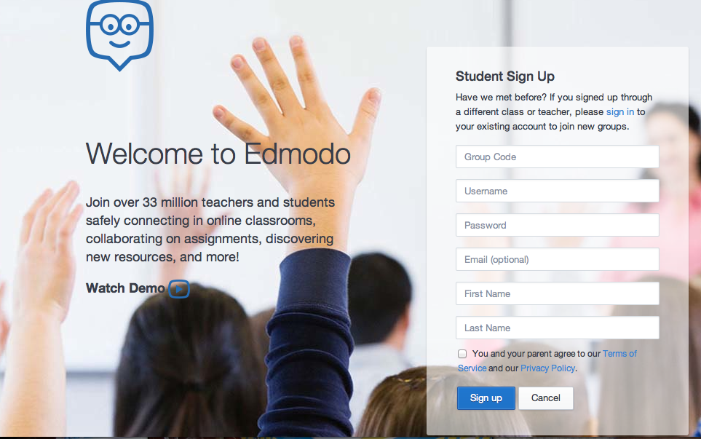
Student sign-up page:
Notes:
Students only need a code in order to sign up. No email address, no Facebook account, just the group code.
Other information is self-generated.
Usernames need to be unique (numbers etc. may help if the name is common)

Slide 18
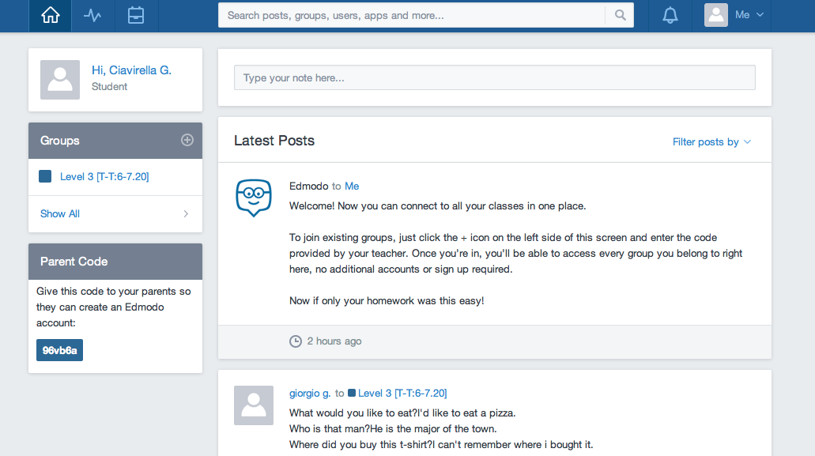
Student home-page:
Notes:
Can you spot the differences between this and the teacher’s home page?

Slide 19
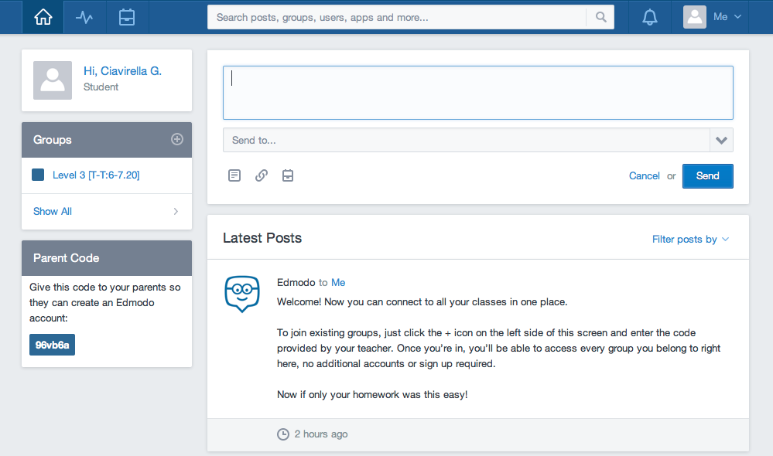
To communicate:
Notes:
Students can type and send notes, just like the teacher.
Students can add links and files, just like the teacher.
Students need to choose who to send their notes/files/links to. (There is an option to send things to themselves – they may do this accidentally instead of choosing the class. Good to point out!)

Slide 20
Integrating Edmodo
Your ideas?
My ideas:
For homework -
http://reflectiveteachingreflectivelearning.com/2014/02/07/5-ways-of-using-edmodo-with-language-learners-part-1/
For autonomy -
http://reflectiveteachingreflectivelearning.com/2014/02/20/5-ways-of-using-edmodo-with-language-learners-part-2/

Slide 21
But, but, but…
(potential issues)
But what if my students don’t like social media?
But what if my students don’t use Edmodo?
But what if my students think this is a stupid idea?
But I don’t have *time* for this!!
But how do I give feedback?
…any more?

Slide 22

Any questions?
www.en.hydo.org

